Slide 1




Factory Pattern
 Factory pattern is one of the most used design patterns in Java. This type of design pattern comes under creational pattern as this pattern provides one of the best ways to create an object.
 In Factory pattern, we create object without exposing the creation logic to the client and refer to newly created object using a common interface.

Slide 2

Implementation
 We're going to create a Shape interface and concrete classes implementing the Shape interface. A factory class ShapeFactory is defined as a next step.
 FactoryPatternDemo, our demo class will
use ShapeFactory to get a Shape object. It will pass information (CIRCLE / RECTANGLE / SQUARE) to ShapeFactory to get the type of object it needs.

Slide 3

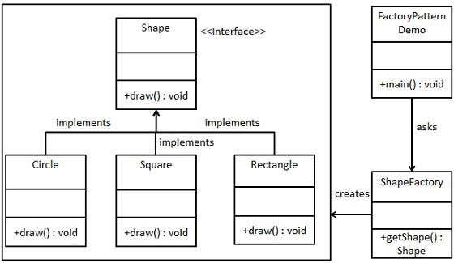
Implementation

Slide 4

Step 1
 Create an interface. (Shape.java)
public interface Shape {
void draw();
}

Slide 5

Step 2
 Create concrete classes implementing the same interface.
public class Rectangle implements Shape { @Override
public void draw() {
System.out.println("Inside Rectangle::draw() method.");
} }
public class Square implements Shape { @Override
public void draw() {
System.out.println("Inside Square::draw() method.");
} }
public class Circle implements Shape { @Override
public void draw() {
System.out.println("Inside Circle::draw() method.");
} }

Slide 6

Step 3
 Create a Factory to generate object of concrete class based on given information. (ShapeFactory.java)
public class ShapeFactory {
//use getShape method to get object of type shape
public Shape getShape(String shapeType){ if(shapeType == null){
return null;
}
if(shapeType.equalsIgnoreCase("CIRCLE")){
return new Circle();
} else if(shapeType.equalsIgnoreCase("RECTANGLE")){ return new Rectangle();
} else if(shapeType.equalsIgnoreCase("SQUARE")){
return new Square();
}
return null;
} }

Slide 7

Step 4
 Use Factory to get object of concrete class by passing information such as type. (FactoryPatternDemo.java)
public class FactoryPatternDemo {
public static void main(String[] args) { ShapeFactory shapeFactory = new ShapeFactory(); Shape shape1 = shapeFactory.getShape("CIRCLE"); shape1.draw();
Shape shape2 = shapeFactory.getShape("RECTANGLE"); shape2.draw();
Shape shape3 = shapeFactory.getShape("SQUARE"); shape3.draw();
}
}

Slide 8

Step 5
 Verify the output.
Inside Circle::draw() method. Inside Rectangle::draw() method. Inside Square::draw() method.

